Slide 1
Multi-Qubit QKD CP-ABE Model for Cloud Security
Ch.Jatin
D.Prem Sai
N.Abhishek

Slide 2
Contents
1
4
Introduction
CP-ABE for Secure Cloud Data Sharing
2
5
The Multi-Qubit QKD CP-ABE Model (Overview)
Security Against Attacks (Dense-Coding & Eavesdropping)
3
6
How Quantum Key Distribution Works
Results & Conclusion

Slide 3
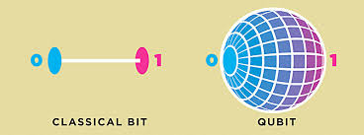
Introduction
Importance of Cloud Security
The Threat of Quantum Computing
Cloud computing exposes sensitive data to cyber threats.
Traditional encryption (AES, RSA) is secure today but vulnerable to quantum attacks
Shor’s Algorithm can break RSA and ECC encryption in polynomial time.
A future quantum computer could decrypt existing encrypted data.

Slide 4
The Multi-Qubit QKD CP-ABE Model (Overview)
Goal of the model:
How it works:
To secure cloud data using a combination of:
Multi-Qubit Quantum Key Distribution (QKD) – Ensures secure key exchange.
Ciphertext-Policy Attribute-Based Encryption (CP-ABE) – Controls who can access encrypted data.
Alice generates a quantum key using multi-qubit states.
Bob measures the received qubits and agrees on a secret key.
If the key is verified (no eavesdropping detected), it is used for CP-ABE encryption.
Cloud data is encrypted using CP-ABE policies → Only authorized users can decrypt.

Slide 5
Workflow

Slide 6
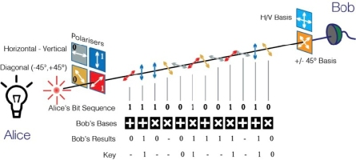
Quantum Key Distribution
Alice sends Qubits: Alice wants to send two bits: 1 and 0.
She randomly chooses bases: For 1, she picks the diagonal (×) basis and encodes it as |−⟩ = (|0⟩ - |1⟩)/√2. For 0, she picks the rectilinear (+) basis and encodes it as |0⟩ (horizontal polarization).
She sends these qubits to Bob.
Bob Measures Qubits: Bob randomly picks bases to measure each qubit:
For the 1-qubit, he picks the rectilinear (+) basis, which does not match Alice's (×). His result is random (50% chance of 0 or 1).
For the 0-qubit, he picks the rectilinear (+) basis, which matches Alice's. He correctly gets 0.
Public Basis Comparison: Alice and Bob publicly compare their chosen bases (not the actual bit values).
For the 1-qubit, Alice used × and Bob used +, so they discard this bit.
For the 0-qubit, both used +, so they keep this bit
Key Verification & Error Checking:
Alice and Bob publicly check a few bits to detect errors.
If errors are too high, they abort the key exchange (possible eavesdropper).
Otherwise, the final shared key is generated using the correctly measured bits.

Slide 7
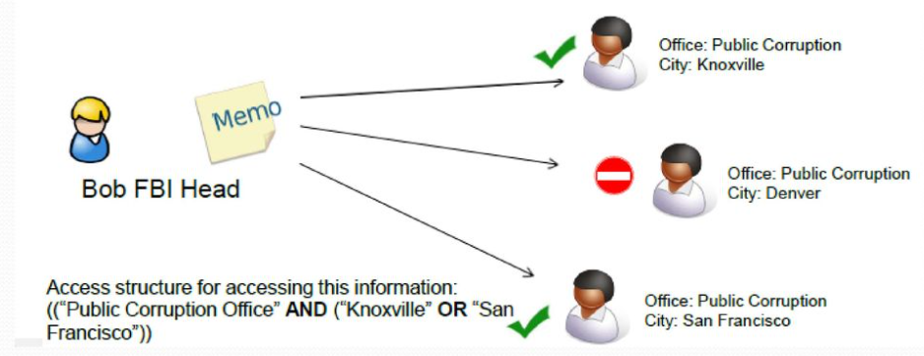
How CP-ABE Ensures Secure Cloud Data Sharing
What is CP-ABE?
Ciphertext-Policy Attribute-Based Encryption (CP-ABE) allows data to be encrypted with an access policy
Only users with matching attributes can decrypt the data.
Example:
A company encrypts salary data with the policy
(Role = “Manager” AND Department = “Finance”)
A Finance Manager can decrypt.
An HR Employee cannot decrypt
Why Use CP-ABE with QKD:
QKD secures the encryption key, ensuring it’s safely shared.
CP-ABE enforces access control, preventing unauthorized decryption.

Slide 8
Security Aspects of the Model
Eavesdropping Protection – The No-Cloning Theorem prevents perfect copying of qubits, while decoy qubits detect any interception attempts.
Defense Against Dense-Coding Attacks – Eve’s attempts to entangle qubits are disrupted by random basis selection, making unauthorized key extraction impossible.
Key Integrity – Public error checking detects tampering or noise. If the error rate is too high, the key exchange is aborted to prevent compromised encryption.
Chaotic Quantum Key Generation (CQKG) for Unpredictability – Enhances key randomness using a chaotic logistic map.
CP-ABE Access Control – Encrypted data remains secure since only users with matching attributes can decrypt it, even if the ciphertext is intercepted.
Extended Secure Transmission – Multi-Qubit QKD increases the transmission range and improves key generation rates, making it more resilient against distance-based attacks.

Slide 9
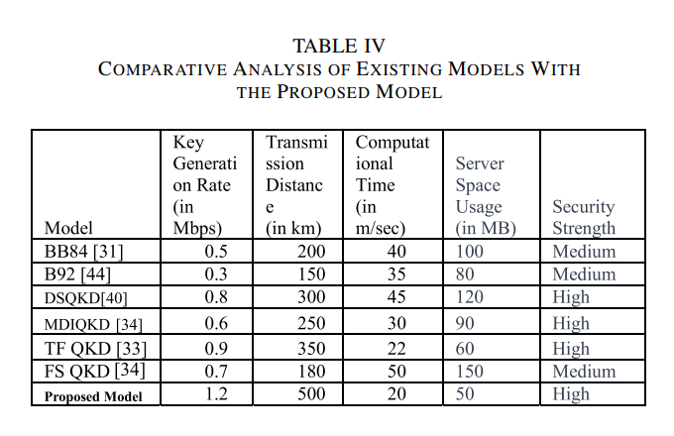
Results
Key Generation Rate:
Existing QKD Models: 0.5 – 0.9 Mbps
Proposed Multi-Qubit QKD: 1.2 Mbps
Increased key generation rate for faster, more efficient key exchange
Transmission Distance:
Existing QKD Models: 200 – 350 km
Proposed Multi-Qubit QKD: 500 km
Longer secure transmission range with multi-qubit entanglement.
Security Strength:
Existing QKD Models: Medium - High
Proposed Multi-Qubit QKD: High
Stronger resistance to quantum attacks, including dense-coding and eavesdropping.
Computational Time:
Existing QKD Models: 22 – 50 ms
Proposed Multi-Qubit QKD: 20 ms
Reduced computational time, enhancing performance and scalability.
Server space usage (mb):
Existing QKD models: 60 - 150.
Proposed model: 50.
Reduced space usage

Slide 10
Conclusion
Improved Security:
Multi-Qubit QKD provides robust security against quantum attacks and eavesdropping.
Higher Efficiency:
Faster key generation and extended transmission distances enable better scalability for real-world applications.
CP-ABE Integration:
Combines quantum security with efficient, attribute-based access control, ensuring both confidentiality and authorized access to cloud data.
Future Work:
Expanding model integration into IoT networks and further optimizing error correction methods.

Slide 11
The End
THANK YOU FOR LISTENING

